Slide 1
MOVIE SUCCESS PREDICTION
USING MACHINE LEARNING AND AI
An Intelligent Framework for Movie Classification and Research
Presented by: Darsan IS
Capstone Project · Boston Institute of Analytics
Notes:
[~30 sec] Good morning/afternoon. I'm Darsan IS, and my capstone project is Movie Success Prediction using Machine Learning and AI. In short: we take movie metadata known BEFORE release and classify each film as a Flop, Average or Hit, based on its eventual IMDb rating band. The core of the project is machine learning. On top of that I added an Agentic AI layer that researches and explains movies. I'll walk through the problem, data, methodology, results, and then the AI extension.

Slide 2
Roadmap: From Movie Data to Intelligent Insights
01 · ROADMAP
THE PROBLEM
THE MACHINE LEARNING
RESULTS & EXTENSION
Problem Statement
Why movie success is hard to estimate
Preprocessing & EDA
Leakage-safe pipeline and key patterns
Results & Key Findings
Honest held-out performance
1
4
7
Project Objectives
Seven goals, machine learning first
Architecture & Workflow
Data → ML → App → Agentic AI
Agentic AI Integration
AI Movie Researcher and Assistant
2
5
8
Dataset Description
5,043 films → 4,919 cleaned
Model Evaluation
14 algorithms, 42 configurations
Conclusion
Limitations and future scope
3
6
9
Notes:
[~30 sec] This is the journey. First, the problem and the data. Second, the machine learning work: preprocessing, the system architecture, and a large model comparison, which is where most of my time went. Third, the results, and finally the Agentic AI addition. About two thirds of this talk is machine learning, and the AI layer is an extension on top.

Slide 3
Problem Statement: Estimating Success Before Release
02 · PROBLEM
Movie Metadata
9 pre-release inputs
Prediction Challenges
Missing values · imbalance · noise
ML Classification
14 algorithms compared
Rating Category
Flop · Average · Hit
Why it matters
Main technical challenges
IMDb rating ≠ commercial success
Release decisions are made under uncertainty
A useful estimate must use only what is known BEFORE release: no votes, reviews or box office
Early signal supports planning; it is not a guarantee
Missing values: budget 9.9%, aspect ratio 6.6%, content rating 6.1%
Severe imbalance: 41 Flops vs 3,495 Hits
Mixed numeric and categorical metadata; budget mixes currencies
Label = IMDb score band: Flop < 3, Average 3 to < 6, Hit ≥ 6
It is not box office or profit
Output is an estimated rating category
Notes:
[~45 sec] The problem: movie success is hard to estimate because many things affect how an audience receives a film. Our dataset is messy: missing values, mixed numeric and categorical fields, and a heavily imbalanced target, with only 41 Flops among 4,919 films. The task is to classify a film into a rating category using only information available before release. One important clarification: our label is an IMDb rating band, not box-office revenue or profit, so this is not a commercial-success predictor.

Slide 4
Project Objectives
03 · OBJECTIVES
1
2
3
4
Analyze movie metadata
Discover meaningful patterns across 5,043 films
Clean and explore the data
Duplicates, missing values and exploratory analysis
Pre-release classification pipeline
Predict using only information known before release
Compare algorithms and imbalance strategies
14 algorithms, 42 configurations
5
6
7
Evaluate honestly
Accuracy, Macro F1 and Balanced Accuracy
Interactive prediction application
FastAPI backend with a React frontend
Agentic AI extension
AI Movie Researcher and AI Assistant
Objectives 1–5: machine learning core · 6: application · 7: advanced extension
Notes:
[~30 sec] Seven objectives. The first five are the machine-learning core: understand the data, clean it, build a leakage-free pre-release pipeline, compare many algorithms and imbalance strategies, and evaluate with metrics that suit imbalanced data. Objective six is the interactive application, and objective seven is the Agentic AI extension, which is deliberately last because it builds on the ML work.

Slide 5
Dataset: Imbalance Is the Central Challenge
04 · DATASET
5,043
28
4,919
9
raw records
original columns
cleaned films
pre-release inputs
Class distribution by IMDb score band
Class share
Nine pre-release inputs
NUMERIC
Budget
Duration
4,919
films
Release Year
Aspect Ratio
CATEGORICAL
Genres
Country
Hit (≥ 6) 71.1%
Language
Content Rating
Average (3 to < 6) 28.1%
Colour
Only 41 Flops (0.8%): a model can ignore them and still look accurate
Flop (< 3) 0.8%
Source: dataset/movie_metadata.csv, cleaned with the repository rule (exact duplicates, then same title + year). Counts match docs/PRE_RELEASE_MODEL.md.
Notes:
[~60 sec] The dataset is the IMDb 5000 movie dataset: 5,043 rows and 28 columns. After removing exact duplicates and films scraped twice, we have 4,919 films. We use only nine inputs that are known before release: budget, duration, release year, aspect ratio, genres, country, language, content rating and colour. The key point is on the left: 3,495 Hits, 1,383 Averages and just 41 Flops, which is 0.8 percent. A model can get 71 percent accuracy by always saying Hit, so the imbalance shapes everything about how we train and evaluate.

Slide 6
Data Preprocessing & Exploratory Analysis
05 · PREPROCESSING & EDA
Leakage-safe pipeline
fitted on training folds only
Films released per decade
Missing values by input (%)
1
Remove exact duplicates (5,043 → 4,998)
2
Remove same-film duplicates (→ 4,919)
3
Median imputation + missing-value flags
4
Budget log transform + scaling
5
Categorical encoding; missing = "Unknown"
6
Rare categories pooled together
7
Genres → separate binary flags
8
Stratified 80/20 split (3,935 / 984)
Modern catalogue: 73% of films are from 2000 onward, so release year carries era effects.
Skewed budget: median $19.9M but a maximum of $12.2B (mixed currencies), hence the log transform.
Gaps are modest: budget (9.9%), aspect ratio (6.6%) and content rating (6.1%) are filled by median or "Unknown" with missing flags.
Excluded to prevent data leakage
Gross revenue, IMDb votes, user and critic reviews, social-media likes, plot keywords
Charts computed from the cleaned dataset (4,919 films). Pipeline per docs/PRE_RELEASE_MODEL.md, sections 2–4.
Notes:
[~60 sec] On the left is the preprocessing workflow. Everything is fitted inside the ML pipeline on training data only, so no information leaks from the test set: median imputation with missing flags, a log transform and scaling for budget, categorical encoding with an Unknown level, rare categories pooled, and genres as separate flags. I also excluded post-release columns such as gross, votes, reviews and likes, because a pre-release model must not see them. On the right, the EDA shows the data is mostly modern films, budget is heavily skewed, and the missing values are modest but real.

Slide 7
System Architecture & Workflow
06 · ARCHITECTURE
DATA LAYER
AGENTIC AI LAYER · AI MOVIE RESEARCHER
Movie Metadata Dataset
Data Cleaning
Feature Engineering
Wikipedia research via local Ollama model
Runs the pre-release ML model (read-only)
MACHINE LEARNING LAYER
Risk analysis and research report
Preprocessing Pipeline
Trained Classifier (Random Forest)
Prediction Engine
Explainability (SHAP)
Never modifies the ML prediction
APPLICATION LAYER
AI ASSISTANT · GEMINI API
React Frontend
FastAPI Backend
Prediction API
Conversational Q&A on movies and data science; explains stored research
ML prediction
Agentic research
AI-generated explanation
Three separate roles: predict, research, explain
Implementation per README and repository: backend/ml, backend/app (FastAPI), frontend (React), backend/agent (Ollama), backend/gemini (Gemini).
Notes:
[~75 sec] Here is the architecture. At the bottom of the stack, the data layer cleans the dataset and engineers features. The ML layer holds the preprocessing pipeline, the trained Random Forest classifier, the prediction engine and the explainability module. The application layer is a React frontend talking to a FastAPI backend with a prediction API. On the right is the Agentic AI layer, which I added as an extra. The AI Movie Researcher uses a local Ollama model to research a film on Wikipedia, runs the pre-release model, and reports risks. The AI Assistant is a Gemini chat that answers questions and explains stored research. The colour coding matters: blue is the ML prediction, violet is agentic research, cyan is AI explanation. The researcher never changes the prediction.

Slide 8
Model Evaluation: 14 Algorithms, 42 Configurations
07 · EVALUATION
Why Macro F1 and Balanced Accuracy
Finalists: mean Macro F1
Cross-validation, 5×3 identical fresh folds (top 10 of 14 + baseline)
Confusion matrix
Selected model · held-out test, n = 984
Accuracy misleads. Always answering "Hit" gives 71.0% accuracy but only 0.277 Macro F1.
Macro F1 weights all three classes equally; Balanced Accuracy averages per-class recall.
Balancing is a trade-off: mean accuracy falls 75.4% → 68.5% while Flop recall rises 0% → 18%.
Predicted →
Actual ↓
Flop
Average
Hit
Flop
1
4
3
Average
4
197
76
PROTOCOL
Hit
3
166
530
1
Screen all 42 configurations (5×3 CV)
2
Tune the 5 strongest algorithms
Recall: Flop 1 of 8, Average 197 of 277, Hit 530 of 699
Colour = share of each actual class
3
Re-score 14 finalists on fresh folds
Highest mean: XGBoost (cyan). Finalists are statistically tied (paired t < 2), so the simplest was selected (blue): Random Forest · class weights
4
Test set used once, after selection
Source: docs/PRE_RELEASE_MODEL.md and backend/artifacts/comprehensive_results.json. Chart = cross-validation (training set); matrix = held-out test.
Notes:
[~105 sec] This is the heart of the ML work. Accuracy alone is misleading here, because always predicting Hit gives 71 percent. So I focus on Macro F1 and Balanced Accuracy. I evaluated 14 algorithms across 42 combinations with different imbalance strategies, using repeated stratified cross-validation, tuned the five strongest, and re-scored 14 finalists on fresh, identical folds. The bar chart shows cross-validation Macro F1. XGBoost has the highest mean, but the differences are tiny: all finalists are statistically indistinguishable under a corrected paired t-test. So my pre-declared rule picked the simplest model, Random Forest with class weights. I want to be clear that Random Forest is not the outright highest scorer. On the right is the selected model's confusion matrix on the held-out test set, which is a different evaluation from the cross-validation chart. It does reasonably on Average and Hit, but finds only one of eight Flops.

Slide 9
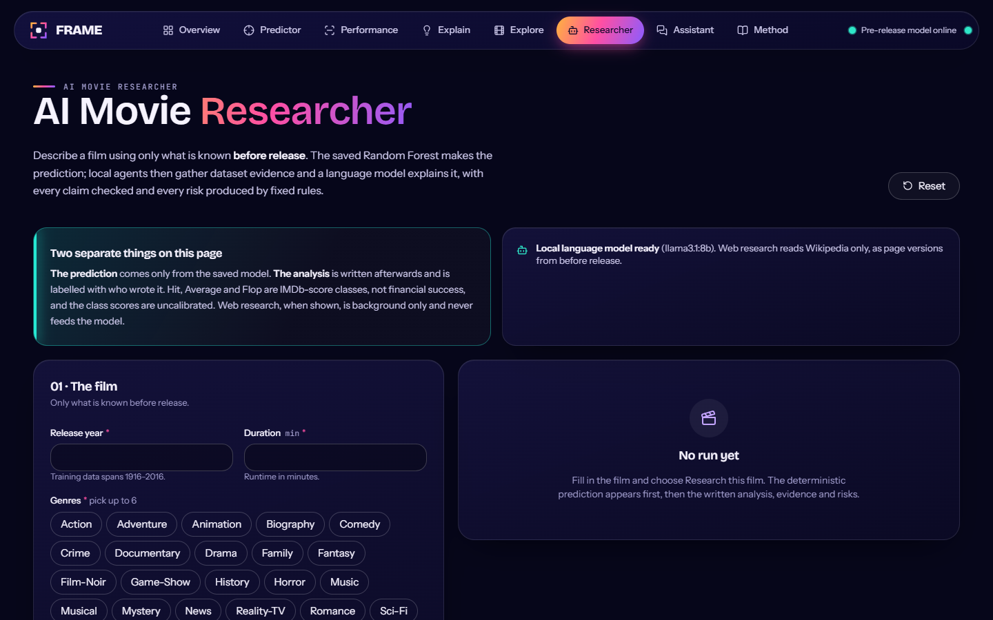
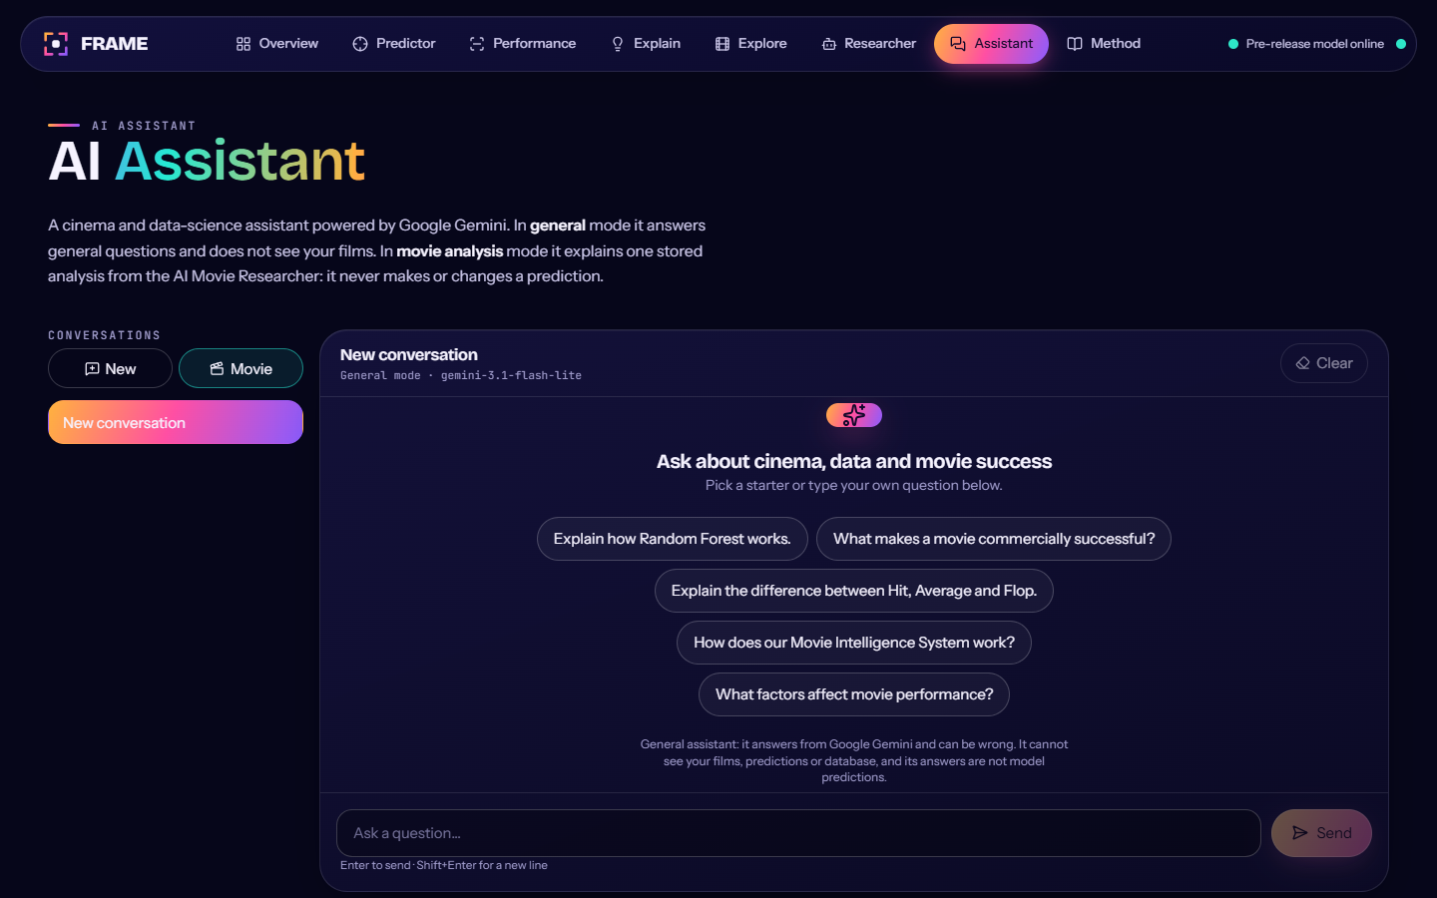
Results, Key Findings & Agentic AI
08 · RESULTS & AGENTIC AI
MACHINE LEARNING RESULTS · held-out test (984 films)
AGENTIC AI ADDITION · extends the ML product
74.0%
53.1%
0.516
Accuracy
Balanced accuracy
Macro F1
majority baseline 71.0%
chance level 33.3%
baseline 0.277
Recall per class (selected Random Forest)
AI Movie Researcher
AI Assistant
Researches a film on Wikipedia with a local Ollama model
Runs the pre-release ML model
Reports risks; never changes the prediction
Gemini-powered chat
Movie and data-science questions
Explains a stored movie analysis
Flop detection remains weak: 1 of 8 test Flops found; only 41 exist. The gain over baseline is modest and lies mainly in balanced accuracy.
An additional layer: the ML prediction stays the source of truth; the AI components add research context and explanation.
Source: docs/PRE_RELEASE_MODEL.md (held-out test, Random Forest · class weights); screenshots from docs/screenshots in the repository.
Notes:
[~105 sec] On the left, the verified held-out test results for the selected Random Forest. Accuracy is 74.0 percent against a 71.0 percent baseline, balanced accuracy is 53.1 percent against 33.3 percent for chance, and Macro F1 is 0.516. Recall is 0.71 for Average and 0.76 for Hit, but only 0.12 for Flop, which means one of eight Flops. I don't want to hide that: there are only 41 Flops in the whole dataset, so no model here is reliable on that class. On the right is the Agentic AI addition, shown with real screenshots from the application. The AI Movie Researcher looks up a film, runs the pre-release model and lists risks, and it never changes the prediction. The AI Assistant is a Gemini chat that answers general questions or explains a stored analysis. These layers add context around the ML result; they do not replace it.

Slide 10
Conclusion, Limitations & Future Scope
09 · CONCLUSION
What we built
Limitations
Future scope
Pre-release classification pipeline with no post-release leakage
14 algorithms and 42 imbalance configurations compared
Random Forest chosen by a pre-declared selection rule
ML prediction served through an interactive app
Agentic AI research and assistant layer added on top
Highly imbalanced classes
Only 41 Flops; 8 in the test set
IMDb rating bands are not commercial success
Finalists are statistically tied
Predictions are estimates, not guarantees
Improve minority-class (Flop) prediction
Explore more reliable pre-release features
Improve generalisation to newer films
Expand movie research capabilities
From movie data to intelligent insights: a modest but honest pre-release signal, extended by agentic research.
Notes:
[~45 sec] To conclude: I built a leakage-free, pre-release movie classification pipeline, compared 14 algorithms and 42 configurations with a rule fixed in advance, and picked Random Forest with class weights. The model is served through an interactive app and extended with Agentic AI for research and explanation. Limitations: the data is highly imbalanced with only 41 Flops, the label is an IMDb band rather than commercial success, and predictions are estimates. Future work: better minority-class prediction, more reliable pre-release features, and better generalisation to newer films. Thank you.

Slide 11
THANK YOU
QUESTIONS?
Notes:
[~15 sec] Thank you for listening. I'm happy to take questions about the model, the evaluation, or the AI components.

